Slide 1
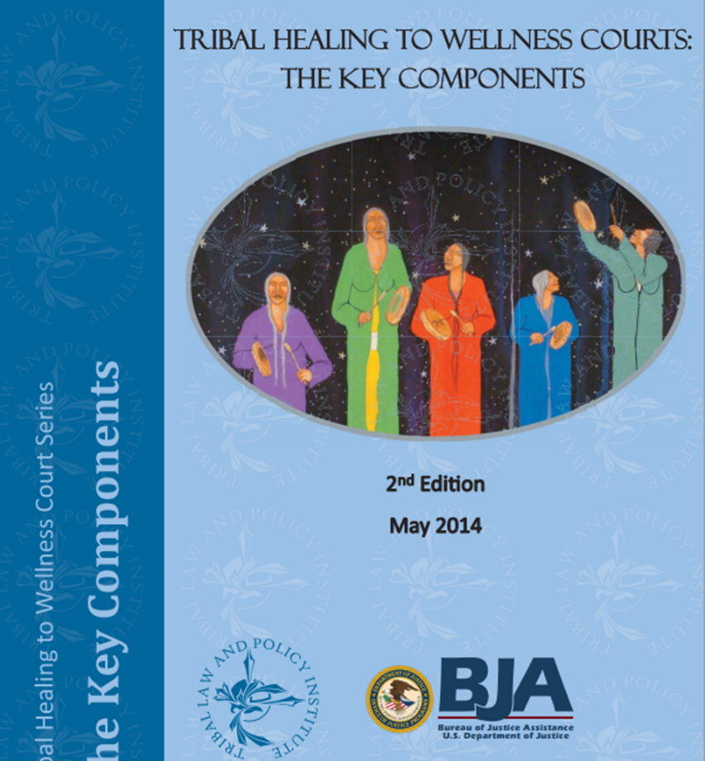
Tribal Key Components
Tribal Key Components recognize:
Community involvement
Family relationships and involvement
Culture and Tradition
Exercise of Tribal Sovereignty
www.WellnessCourts.org
Notes:
-10 Key Components are adapted from the from the operational components for State Drug Courts
-Recognizing:
-Community Involvement: of the team, the participant, tribal leadership
-Family Relationships & Involvement: Clanship, extended families, renewing positive relationships
-Culture & Tradition: Addiction affects a person’s connection to these. HTWC incorporates as a holistic response
-Exercise of Tribal Sovereignty: creating a response

Slide 2
Sustained Team, Community, & Nation Building
Team, Community, & Nation Building
Enduring Knowledge & Experience
Eligibility
Healing to Wellness Court
10 Key Components
Entry
Keeping and Telling Stories
Healing and Treatment
Respectful Communication
Discipline & Encouragement
Support & Supervision

Slide 3
Key Component #1: Individual and Healing Focus Through Nation Building
Brings together treatment, healing resources, and the tribal justice process by using a team approach to achieve the healing of the participant and to promote Native nation building and the well-being of the community.
Notes:
-Goal of Tribes is to have members in “good standing”, productive members.
-Modern problems, traumatic historical events, addiction have interfered with our tribal members from being “productive members in good standing”
-Goal of HTWC:
1. Reduce the use & abuse of alcohol & other drugs
2. Reduce criminal activity related to the use & abuse of alcohol & drugs
3. Juvenile Delinquency
4. Civil Child Neglect
All this is done as a team approach. Between Tribal Agencies, Non-Tribal Agencies, Judicial system, Law Enforcement. “Thou Shall All Play Together”.
Planning from referral to aftercare should include people from all areas of the judicial system, treatment providers, tribal leaders, local stakeholders, elders & others.
Group should be stable for a period of time & Keep leadership informed.
Traditional individuals (i.e. healers…)
Record of key program design decisions & intent behind the decisions should be kept, for future & initialization of HTWC
Documents should be collectively developed
Documents defining team member roles, possible MOA/MOUs, job descriptions,
Shared decision making
Cross Training
Community should be educated
Alumni groups encouraged

Slide 4
Tips for Key Component #1
Advisory Board/Steering Committee:
Elders
Other programs such as housing, social services
Cultural partners
Improved Collaboration: MOU/MOAs
Within tribe
With county and state agencies

Slide 5
Key #3: Screening and Eligibility
Eligible court-involved substance-abusing candidates are identified early through legal and clinical screening for eligibility and are promptly placed into the Wellness Court.
Screening
Assessments
Notes:
-A traumatic or life changing event involving substance abuse has just happened. Now Law Enforcement & the Tribal Court system are involved. If children were involved, possibly social services. A person’s substance abuse or addiction is now front & center.
-now is a window of time in which a person can began the process of being considered for or considering HTWC.
-Legal Screening:
-potential participants are identified by legal criteria set by the HTWC team
-vary by tribal court, may include drug & alcohol related crimes ( i.e. public intoxication, possession, disorderly conduct, DWI, etc.). We also need to look at those crimes such as burglary, embezzlement.
Ask participants: “what is legal criteria for getting into HTWC?”
Clinical Screening: Screening gets us in the “ballpark”. Describe POL BHS screening packet.
Lengthier assessment can be done as participant is going through the process to better develop a treatment plan.

Slide 6
Tips for Key Component #3
Legal and Clinical Eligibility Criteria
Formalize criteria in Policies and Procedures Manual
Applied uniformly
Universal Screening
Applied to ALL individuals coming into the tribal justice system to avoid falling through the cracks
Screening Tool
Tools should be standardized, scientifically sound, and appropriate for the population served.
Training for staff administering and reading results
Assessment Process
Completed for every person accepted into HTWC to validate substance abuse/dependence diagnoses
Notes:
-Goal of Tribes is to have members in “good standing”, productive members.
-Modern problems, traumatic historical events, addiction have interfered with our tribal members from being “productive members in good standing”
-Goal of HTWC:
1. Reduce the use & abuse of alcohol & other drugs
2. Reduce criminal activity related to the use & abuse of alcohol & drugs
3. Juvenile Delinquency
4. Civil Child Neglect
All this is done as a team approach. Between Tribal Agencies, Non-Tribal Agencies, Judicial system, Law Enforcement. “Thou Shall All Play Together”.
Planning from referral to aftercare should include people from all areas of the judicial system, treatment providers, tribal leaders, local stakeholders, elders & others.
Group should be stable for a period of time & Keep leadership informed.
Traditional individuals (i.e. healers…)
Record of key program design decisions & intent behind the decisions should be kept, for future & initialization of HTWC
Documents should be collectively developed
Documents defining team member roles, possible MOA/MOUs, job descriptions,
Shared decision making
Cross Training
Community should be educated
Alumni groups encouraged

Slide 7
Key #2: Referral Points and Legal Process
Participants enter Wellness Court through various referral points and legal processes that promote tribal sovereignty and the participant’s due (fair) process rights.
Pre/Post Disposition
Diversion
Transfer from another jurisdiction
Civil Dependency Case
Eligibility
Pre- or Post- Court Involvement
Notes:
This allows for the full exercise of Tribal Sovereignty.
In designing, implementing & operating a HTWC.
Tribes must develop an infrastructure, process & procedure that is fair to the participants & their families; while being culturally appropriate & that meets the needs of the community.
Identification of an “entry point” must be determined.
Ordinarily, criminal matters relating to substance abuse; but in HTWC to possibilities can include: social service cases, referrals from the housing authority, self referrals, referrals from “traditional peace making”.
Pre-Charge: can be as recommendation from prosecutor, self referral, probation officer.
Happens after arrest, but before criminal charges are filed.
Post-plea: case has been adjudicated. Plea agreement has been negotiated
Post-conviction: Found Guilty. Judge may order a sentencing. Possibly come from incarceration.
Transfer: from another tribal jurisdiction, State or county jurisdiction. MOA/MOU’s possibly in place.
Making HTWC part of a reunification case plan for Social Services cases
Suitability determinations have been found to have no impact on graduation rate or post program recidivism.

Slide 8
Tips for Key Component #2
Common Referral Sources
Tribal Court
County/State Court
Peacemaking Program
Social Services
Self referral
Probation
Common “Entry Points”
Pre-disposition: After arrest, before criminal charges are filed.
Post-plea: Case has been adjudicated; Plea agreement has been negotiated.
Post-disposition: Found guilty. Judge may order sentencing.
Transfer: from another tribal, state, or county jurisdiction. MOA/MOUs in place.
Notes:
-Goal of Tribes is to have members in “good standing”, productive members.
-Modern problems, traumatic historical events, addiction have interfered with our tribal members from being “productive members in good standing”
-Goal of HTWC:
1. Reduce the use & abuse of alcohol & other drugs
2. Reduce criminal activity related to the use & abuse of alcohol & drugs
3. Juvenile Delinquency
4. Civil Child Neglect
All this is done as a team approach. Between Tribal Agencies, Non-Tribal Agencies, Judicial system, Law Enforcement. “Thou Shall All Play Together”.
Planning from referral to aftercare should include people from all areas of the judicial system, treatment providers, tribal leaders, local stakeholders, elders & others.
Group should be stable for a period of time & Keep leadership informed.
Traditional individuals (i.e. healers…)
Record of key program design decisions & intent behind the decisions should be kept, for future & initialization of HTWC
Documents should be collectively developed
Documents defining team member roles, possible MOA/MOUs, job descriptions,
Shared decision making
Cross Training
Community should be educated
Alumni groups encouraged

Slide 9
Tips for Key Component #2
Participants must know what to expect from the program
Participant handbook
Orientation
Contract
If it’s not in the handbook, use caution when proceeding.
Notes:
-Goal of Tribes is to have members in “good standing”, productive members.
-Modern problems, traumatic historical events, addiction have interfered with our tribal members from being “productive members in good standing”
-Goal of HTWC:
1. Reduce the use & abuse of alcohol & other drugs
2. Reduce criminal activity related to the use & abuse of alcohol & drugs
3. Juvenile Delinquency
4. Civil Child Neglect
All this is done as a team approach. Between Tribal Agencies, Non-Tribal Agencies, Judicial system, Law Enforcement. “Thou Shall All Play Together”.
Planning from referral to aftercare should include people from all areas of the judicial system, treatment providers, tribal leaders, local stakeholders, elders & others.
Group should be stable for a period of time & Keep leadership informed.
Traditional individuals (i.e. healers…)
Record of key program design decisions & intent behind the decisions should be kept, for future & initialization of HTWC
Documents should be collectively developed
Documents defining team member roles, possible MOA/MOUs, job descriptions,
Shared decision making
Cross Training
Community should be educated
Alumni groups encouraged

Slide 10
Key #4: Treatment and Rehabilitation
Wellness Court provides access to holistic, structured, and phased alcohol and drug abuse treatment and rehabilitation services that incorporate culture and tradition.
Phases/Behavior Milestones
Evidence-Based Interventions
Cultural/Pro-Social Involvement
Notes:
On a path to Recovery…..not just sobriety.
New working definition of recovery (SAMHSA): Process of change through which individuals improve health and wellness, live a self-directed life and strive to reach their full potential.
HTWC can be a catalyst for recovery.
“Rock Bottom Myth” – Coerced Treatment just as good
Use of evidenced based treatment interventions: IOP, Groups that focus on criminal thinking
Incorporation of culture.

Slide 11
Tips for Key Component #4
Phases
Structure Phases so as not to overwhelm the participant in the early stages
Over programming can have negative effects
Pro-social activities are important
Treatment
Manualized treatment
Treatment Plan Developed
Authentic and intentional use of culture and tradition in programming and treatment services
Notes:
-Goal of Tribes is to have members in “good standing”, productive members.
-Modern problems, traumatic historical events, addiction have interfered with our tribal members from being “productive members in good standing”
-Goal of HTWC:
1. Reduce the use & abuse of alcohol & other drugs
2. Reduce criminal activity related to the use & abuse of alcohol & drugs
3. Juvenile Delinquency
4. Civil Child Neglect
All this is done as a team approach. Between Tribal Agencies, Non-Tribal Agencies, Judicial system, Law Enforcement. “Thou Shall All Play Together”.
Planning from referral to aftercare should include people from all areas of the judicial system, treatment providers, tribal leaders, local stakeholders, elders & others.
Group should be stable for a period of time & Keep leadership informed.
Traditional individuals (i.e. healers…)
Record of key program design decisions & intent behind the decisions should be kept, for future & initialization of HTWC
Documents should be collectively developed
Documents defining team member roles, possible MOA/MOUs, job descriptions,
Shared decision making
Cross Training
Community should be educated
Alumni groups encouraged

Slide 12
Key #5: Intensive Supervision
Participants are monitored through intensive supervision that includes frequent and random drug testing, while participants and their families benefit from effective team-based case management.
Case Management
Supervision
Drug Testing
Notes:
More then just drug testing.
Monitoring v. Supervision (Case Management v. Probation Supervision)
Case Management is team based
The metabolites of most drugs of abuse are detectable in urine for approximately 2-4 days.

Slide 13
Tips for Key Component #5
Supervision
Probation officers
Law Enforcement
Case Plans
Individualized
Trauma-informed care is essential
Drug Testing
Random
Observed
Frequent
Notes:
-Goal of Tribes is to have members in “good standing”, productive members.
-Modern problems, traumatic historical events, addiction have interfered with our tribal members from being “productive members in good standing”
-Goal of HTWC:
1. Reduce the use & abuse of alcohol & other drugs
2. Reduce criminal activity related to the use & abuse of alcohol & drugs
3. Juvenile Delinquency
4. Civil Child Neglect
All this is done as a team approach. Between Tribal Agencies, Non-Tribal Agencies, Judicial system, Law Enforcement. “Thou Shall All Play Together”.
Planning from referral to aftercare should include people from all areas of the judicial system, treatment providers, tribal leaders, local stakeholders, elders & others.
Group should be stable for a period of time & Keep leadership informed.
Traditional individuals (i.e. healers…)
Record of key program design decisions & intent behind the decisions should be kept, for future & initialization of HTWC
Documents should be collectively developed
Documents defining team member roles, possible MOA/MOUs, job descriptions,
Shared decision making
Cross Training
Community should be educated
Alumni groups encouraged

Slide 14
Key #6: Responding to Participant Behavior
Progressive incentives and sanctions are used to encourage participant compliance with Wellness Court requirements. Therapeutic adjustments are made to meet the clinical needs of participants.
Incentives, Sanctions &Therapeutic Adjustments
Phases
Notes:
Positive incentives – Range from *clapping*, positive words, reduction of or granting of privileges, items.
Remember: Participants have not had many opportunities for positive incentives. Have burned bridges. Have not had a Judge or a PO tell them….”Good Job! Way to go for passing your step!”
Sanctions – will cause the some differences among the team members.
Track our sanctions over time. Is a participant getting undue sanctions because they’re a “squeaky wheel”?
But, avoid applying a rigid template. Drug Courts need a reasonable degree of discretion.

Slide 15
Tips for Key Component #6
Incentives and sanctions must be goal-oriented and individualized.
Procedures should be consistent, immediate, and fair.
Be creative and go beyond lists of possible incentives detailed in policy and procedure manual
Determine the Most Valued Privilege for each participant and incorporate into individualized incentives/sanction protocol
Sanctions with little impact are not likely to change behavior (community service, essays, etc)
Detention is LAST RESORT
Strive to meet a 4-to-1 ratio: 4 incentives to every 1 sanction
Notes:
-Goal of Tribes is to have members in “good standing”, productive members.
-Modern problems, traumatic historical events, addiction have interfered with our tribal members from being “productive members in good standing”
-Goal of HTWC:
1. Reduce the use & abuse of alcohol & other drugs
2. Reduce criminal activity related to the use & abuse of alcohol & drugs
3. Juvenile Delinquency
4. Civil Child Neglect
All this is done as a team approach. Between Tribal Agencies, Non-Tribal Agencies, Judicial system, Law Enforcement. “Thou Shall All Play Together”.
Planning from referral to aftercare should include people from all areas of the judicial system, treatment providers, tribal leaders, local stakeholders, elders & others.
Group should be stable for a period of time & Keep leadership informed.
Traditional individuals (i.e. healers…)
Record of key program design decisions & intent behind the decisions should be kept, for future & initialization of HTWC
Documents should be collectively developed
Documents defining team member roles, possible MOA/MOUs, job descriptions,
Shared decision making
Cross Training
Community should be educated
Alumni groups encouraged

Slide 16
Therapeutic Adjustments – Should come from the treatment provider
Give (Enhancements)
Take (Reductions)
New assessment
Trauma Group
More Treatment Groups
Move from Intensive Outpatient to Residential Treatment
Move from Intensive Outpatient to outpatient
Fewer Treatment Groups
Replacing treatment groups with pro-social activities

Slide 17
Key #7: Judicial Interaction
The Wellness Court Judge should have ongoing involvement with the team and with each participant.
Notes:
Important in monitoring participant progress and using authority to promote positive outcomes for the participant.
**REFER TO PAGE 60**

Slide 18
Tips for Key Component #7
Ongoing judicial supervision communicates to participants, often for the first time, that someone in authority cares about them and is closely watching what they do.
Judicial training
Judicial interaction with participants should encourage good behavior while discouraging and penalizing inappropriate behavior.
Notes:
-Goal of Tribes is to have members in “good standing”, productive members.
-Modern problems, traumatic historical events, addiction have interfered with our tribal members from being “productive members in good standing”
-Goal of HTWC:
1. Reduce the use & abuse of alcohol & other drugs
2. Reduce criminal activity related to the use & abuse of alcohol & drugs
3. Juvenile Delinquency
4. Civil Child Neglect
All this is done as a team approach. Between Tribal Agencies, Non-Tribal Agencies, Judicial system, Law Enforcement. “Thou Shall All Play Together”.
Planning from referral to aftercare should include people from all areas of the judicial system, treatment providers, tribal leaders, local stakeholders, elders & others.
Group should be stable for a period of time & Keep leadership informed.
Traditional individuals (i.e. healers…)
Record of key program design decisions & intent behind the decisions should be kept, for future & initialization of HTWC
Documents should be collectively developed
Documents defining team member roles, possible MOA/MOUs, job descriptions,
Shared decision making
Cross Training
Community should be educated
Alumni groups encouraged

Slide 19
Key #8: Monitoring and Evaluation
Process measurement, performance measurement, and evaluation are tools used to monitor and evaluate the achievement of program goals, identify needed improvements, determined participant progress, and provide information to outside agencies.
Notes:
7 Basic Elements:
Program Goals, “are we doing what we said we were going to do?”
Target Population, “are we reaching the people we said we were going to focus on?”
Alcohol & Drug Treatment, “ are we providing the right dosage & appropriate treatment for our participants?”
Court Process, “are we admitting participants in a timely manner? Are drug tests random? Are sanctions& incentives being handed out in a fair & timely manner?”
Units of service, “are participants compliant with requirements? Are participants receiving the services they need?”
Team Member Cooperation, “are team members able to work together?” **Discuss dysfunctional family**
Community Support, “does the community support the HTWC?”
Other things to monitor & evaluate:
Retention rate
Sobriety – what is average stretch of sobriety?
Recidivism – what is rate of in program recidivism? Post program recidivism? How do HTWC participants compare to non-HTWC individuals?
Units of Service – what services positively impacted HTWC participants?
Share this information with Tribal Council, community, other jurisdictions.
Use to improve programming.
Can be gather through “chart review or audit”. Exit Interviews ** Share story of development of Aftercare Phase**

Slide 20
Tips for Key Component #8
Start with defining what success means to the program and to the participant.
Collect and store information electronically for ease of data analysis and report development
Review data collected on a regular basis
Disseminate summary of data collected to key stakeholders. This helps to let others know the impact the HTWC is making in the community.
Notes:
-Goal of Tribes is to have members in “good standing”, productive members.
-Modern problems, traumatic historical events, addiction have interfered with our tribal members from being “productive members in good standing”
-Goal of HTWC:
1. Reduce the use & abuse of alcohol & other drugs
2. Reduce criminal activity related to the use & abuse of alcohol & drugs
3. Juvenile Delinquency
4. Civil Child Neglect
All this is done as a team approach. Between Tribal Agencies, Non-Tribal Agencies, Judicial system, Law Enforcement. “Thou Shall All Play Together”.
Planning from referral to aftercare should include people from all areas of the judicial system, treatment providers, tribal leaders, local stakeholders, elders & others.
Group should be stable for a period of time & Keep leadership informed.
Traditional individuals (i.e. healers…)
Record of key program design decisions & intent behind the decisions should be kept, for future & initialization of HTWC
Documents should be collectively developed
Documents defining team member roles, possible MOA/MOUs, job descriptions,
Shared decision making
Cross Training
Community should be educated
Alumni groups encouraged

Slide 21
Key #9: Continuing Interdisciplinary and Community Education
Attend annual trainings on:
Substance abuse and mental health treatment
Complementary treatment and social services
Behavior modification
Drug and alcohol testing
Team decision making
Continuing interdisciplinary and community education promote effective planning, implementation, and operation.

Slide 22
Tips for Key Component #9
Training for HTWC Practitioners
Wellness Court Enhancement Training
NADCP National Conference
National Council of Juvenile and Family Court Judges (NCJFCJ)
Treatment Courts Online Learning Platform
Treatmentcourts.org
Notes:
-Goal of Tribes is to have members in “good standing”, productive members.
-Modern problems, traumatic historical events, addiction have interfered with our tribal members from being “productive members in good standing”
-Goal of HTWC:
1. Reduce the use & abuse of alcohol & other drugs
2. Reduce criminal activity related to the use & abuse of alcohol & drugs
3. Juvenile Delinquency
4. Civil Child Neglect
All this is done as a team approach. Between Tribal Agencies, Non-Tribal Agencies, Judicial system, Law Enforcement. “Thou Shall All Play Together”.
Planning from referral to aftercare should include people from all areas of the judicial system, treatment providers, tribal leaders, local stakeholders, elders & others.
Group should be stable for a period of time & Keep leadership informed.
Traditional individuals (i.e. healers…)
Record of key program design decisions & intent behind the decisions should be kept, for future & initialization of HTWC
Documents should be collectively developed
Documents defining team member roles, possible MOA/MOUs, job descriptions,
Shared decision making
Cross Training
Community should be educated
Alumni groups encouraged

Slide 23
Key #10: Team Interaction
The Wellness Court should continue to develop and maintain ongoing commitments, communication, coordination, and cooperation among team members, service providers, and the community.

Slide 24
Tips for Key Component #10
Early determination regarding confidentiality. Rules set in place in Policies and Procedures.
Communication between all levels of care must be well-coordinated and flow smoothly.
Regular team staffing with consistent attendance of all team members.
Notes:
-Goal of Tribes is to have members in “good standing”, productive members.
-Modern problems, traumatic historical events, addiction have interfered with our tribal members from being “productive members in good standing”
-Goal of HTWC:
1. Reduce the use & abuse of alcohol & other drugs
2. Reduce criminal activity related to the use & abuse of alcohol & drugs
3. Juvenile Delinquency
4. Civil Child Neglect
All this is done as a team approach. Between Tribal Agencies, Non-Tribal Agencies, Judicial system, Law Enforcement. “Thou Shall All Play Together”.
Planning from referral to aftercare should include people from all areas of the judicial system, treatment providers, tribal leaders, local stakeholders, elders & others.
Group should be stable for a period of time & Keep leadership informed.
Traditional individuals (i.e. healers…)
Record of key program design decisions & intent behind the decisions should be kept, for future & initialization of HTWC
Documents should be collectively developed
Documents defining team member roles, possible MOA/MOUs, job descriptions,
Shared decision making
Cross Training
Community should be educated
Alumni groups encouraged

Slide 25
Questions?

