Slide 1

Key Moments in NADCP History
Best Practice Standards for the Judge in Drug Court
Douglas B. Marlowe, J.D., Ph.D.
National Association of Drug Court
Professionals

Slide 2

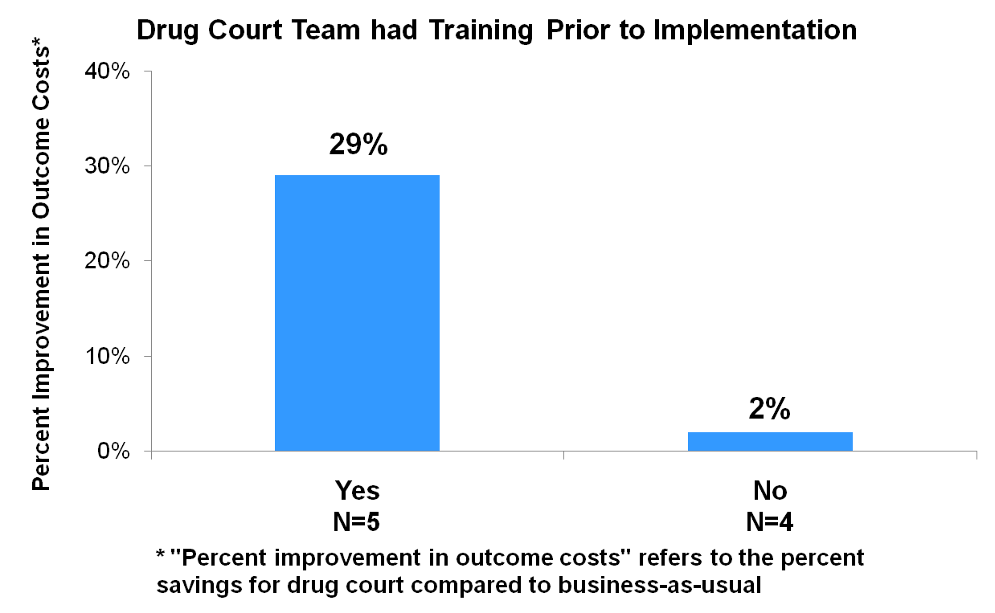
Implementation Training
Ineffective
Carey et al., 2012

Slide 3
Key Moments in NADCP History
Staff Turnover Training
5 times greater cost benefits
}
Neurophysiology of addiction; substance use and
mental health treatment; behavior modification;
community supervision; drug & alcohol testing; judicial ethics and Due Process
Carey et al., 2012

Slide 4
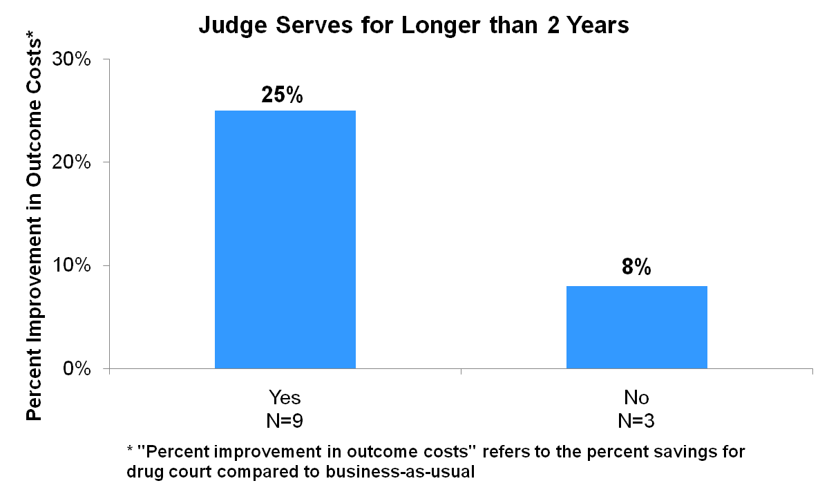
Judicial Term
Three times greater cost benefits
}
Carey et al., 2012

Slide 5
Consistent Docket
Re-arrest rate
# judges presiding
Goldkamp et al., 2002

Slide 6
Key Moments in NADCP History
Consistent Docket
Best
outcomes
58%
51%
*
Re-arrest rate
39%
# judges presiding
Goldkamp et al., 2002

Slide 7
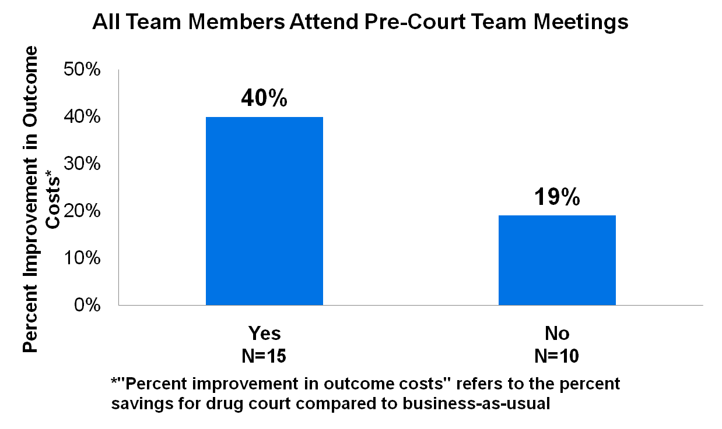
Key Moments in NADCP History
Pre-Court Staffings
Structre
Twice the cost benefits
Twice the cost benefit
}
}
Carey et al. (2012)

Slide 8
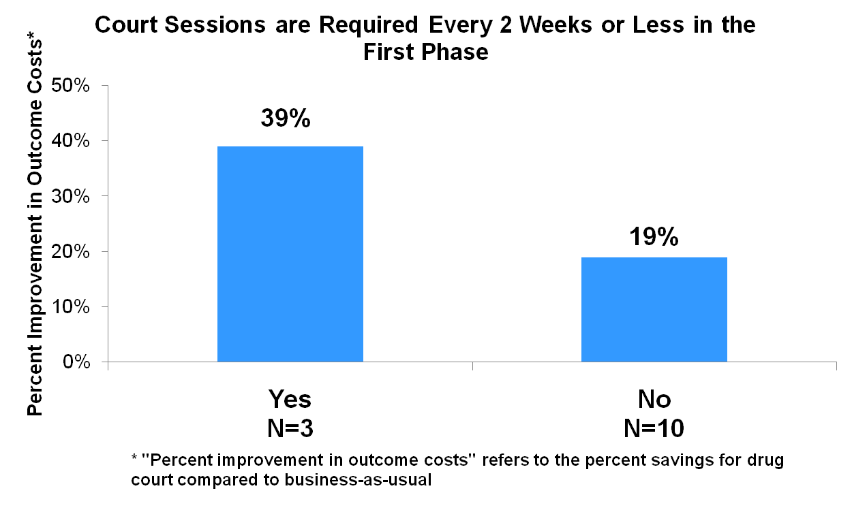
Key Moments in NADCP History
Status Hearings
Structre
Twice the cost benefit
}
Carey et al. (2012)

Slide 9
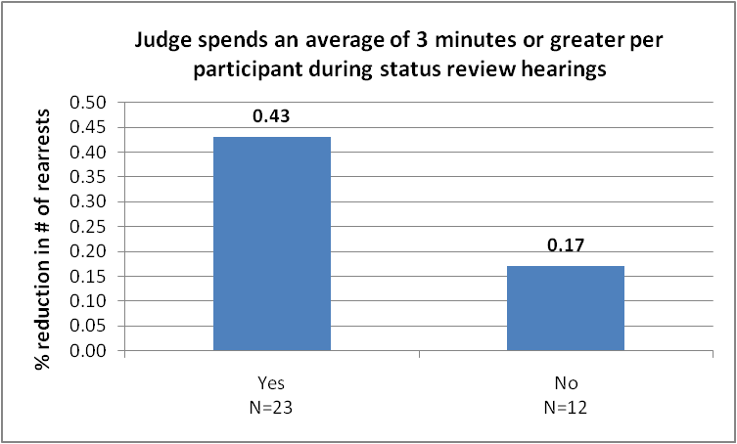
Key Moments in NADCP History
Length of Interactions
Structre
Two and a half times the reduction in crime
Twice the cost benefit
43%
}
}
17%
Carey et al. (2012)

Slide 10
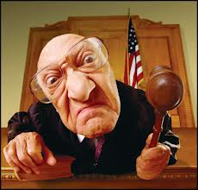
Key Moments in NADCP History
Judicial Qualities
Voice, Neutrality, Respect, Knowledge & Optimism
4.2 *
3.6 *
# Crimes averted
0.7
* p < .05
Rossman et al., 2011; Zweig et al., 2012

Slide 11
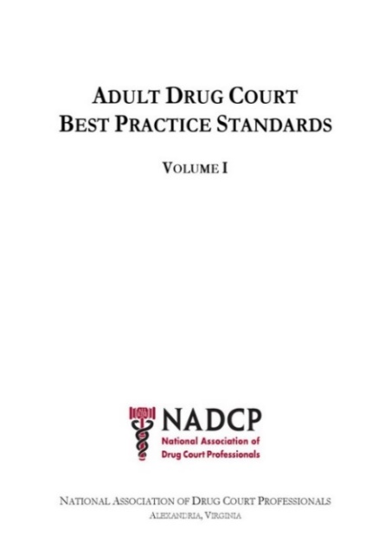
Key Moments in NADCP History
III. Roles of the Judge
Contemporary knowledge; active engagement; professional demeanor; leader among equals
Professional training
Length of term
Consistent docket
Pre-court staff meetings
Frequency of status hearings
Length of court interactions
Judicial demeanor
Judicial decision-making

Slide 12
Key Moments in NADCP History
Summary
High risk and high need individuals require active judicial supervision
Judges require training, experience, consistency, and empathy
Judges must heed scientific evidence
There is no discernible tension between the above and Due Process or traditional judging

